Slide 1
Portable Ultrasound Device (PUD) for Coda-Wave Interferometry
Final Demo
Prepared by Michael Kisellus, Christopher Coppedge,
Leyton Foxworthy, Matthew Baker, Kyle Fox
Product owner : Dr. Brown
07 DEC 2023

Slide 2
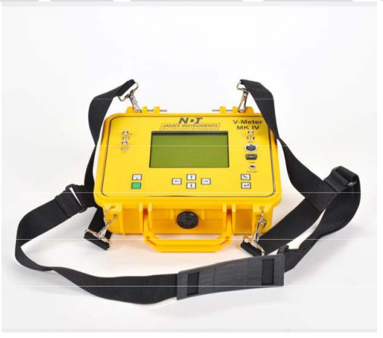
Project Goal
Produce a handheld ultrasound inspection device for inspecting a bridge/structural component for faults in the field.
This handheld unit gathers and stores test data collected over time (48 to 72 hours).
Budget - $2000
Existing commercial solution:
Expensive ($5200)
Is not able to record without an operator present

Slide 3
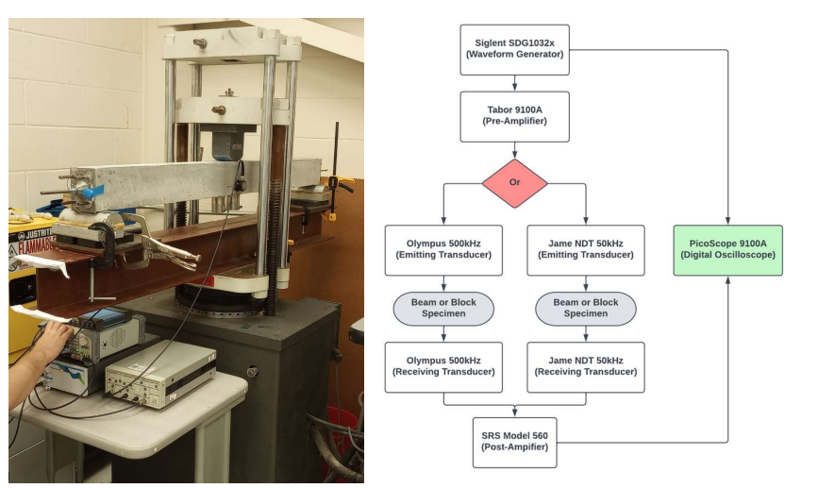
Background
Civil engineering lab has a concrete “scanning” process that involves measuring how ultrasonic waves travel through the concrete

Slide 4
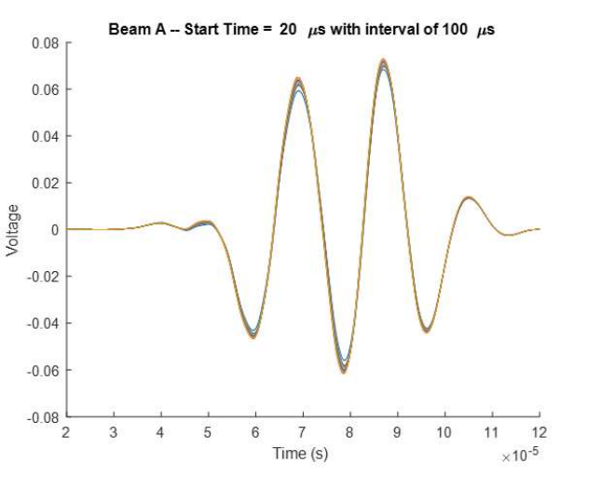
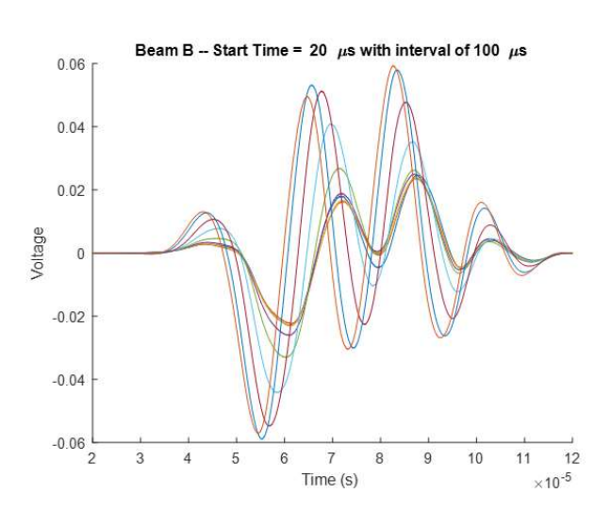
Background
Data analysis, using MATLAB, can reveal imperfections in the concrete.
Scan of an undamaged section of concrete
Scan of a compromised section of concrete

Slide 5
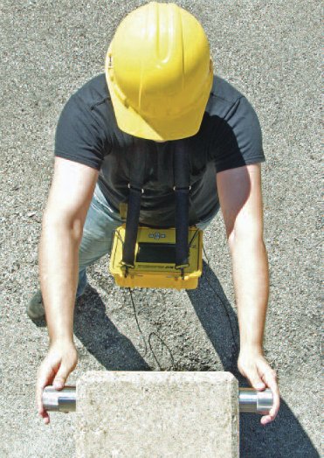
Summary Of Major
Requirements
The Portable Ultrasound Device (PUD) shall be portable and usable by a single operator.
The PUD shall initiate testing and record the resulting data.
The PUD shall operate for 48 to 72 hours without exterior inputs.
The PUD shall operate in outdoor/ field environment

Slide 6
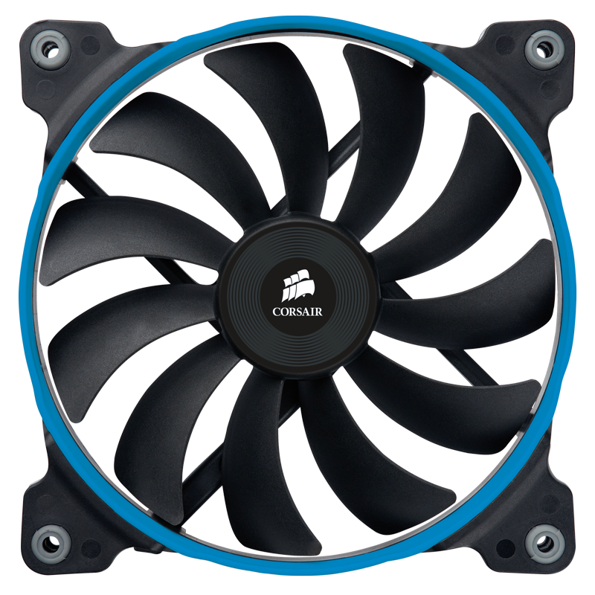


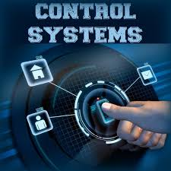
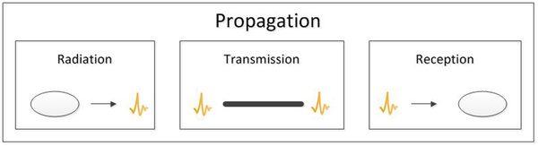
Summary Of The Final Design & Product
Sub systems :
Electrical system
Cooling system
Software
Transmit (Tx) and Receiver (Rx) system
Control system
Enclosure and mounting system

Slide 7
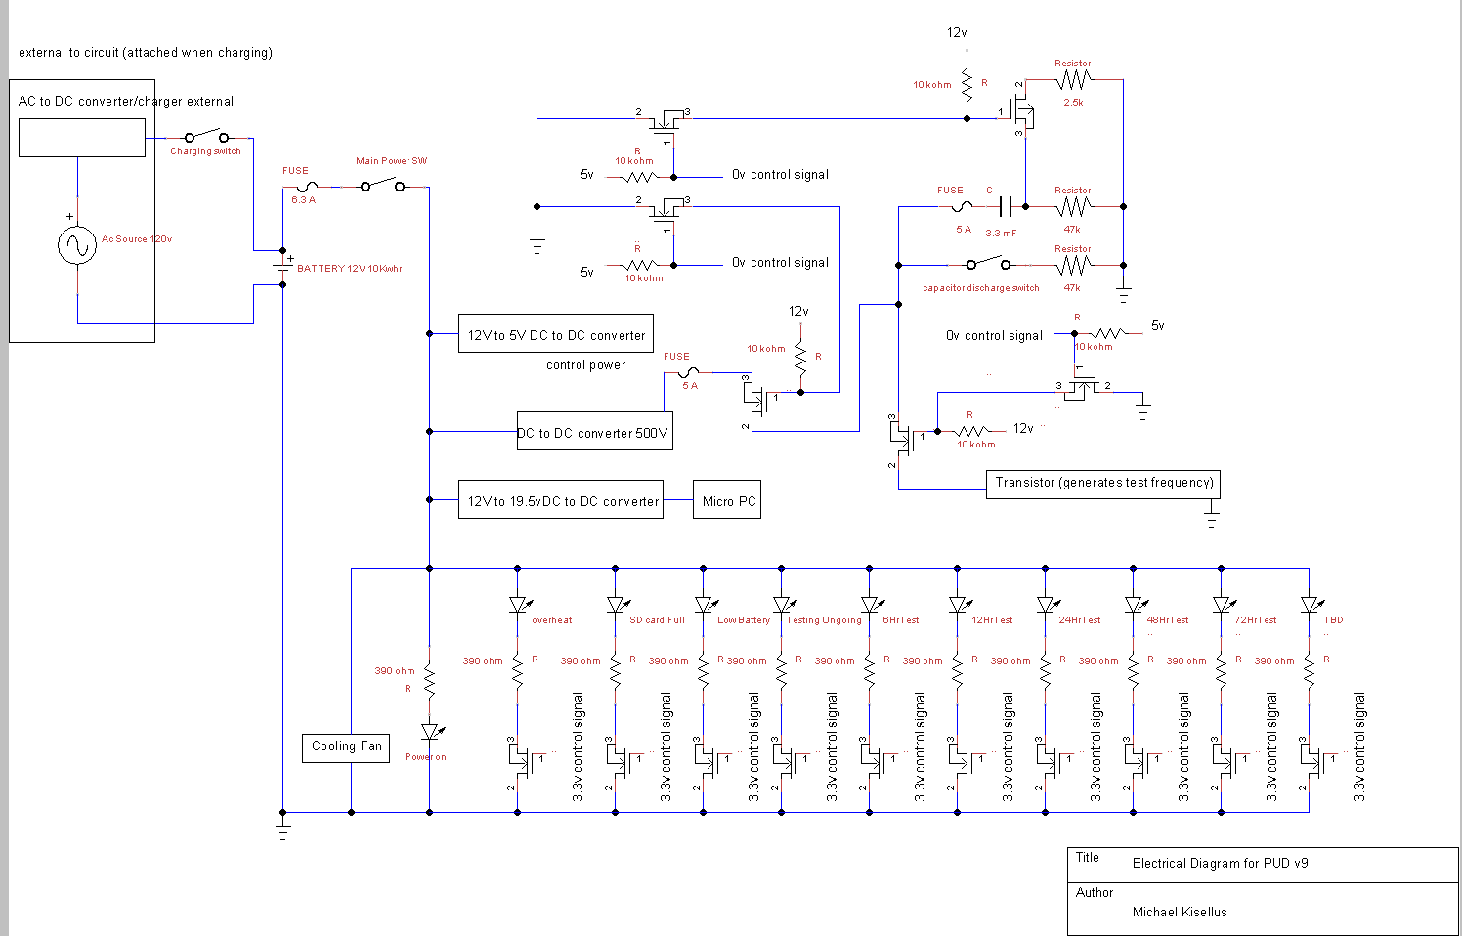
Electrical System

Slide 8
Electrical System: Low Voltage

Slide 9
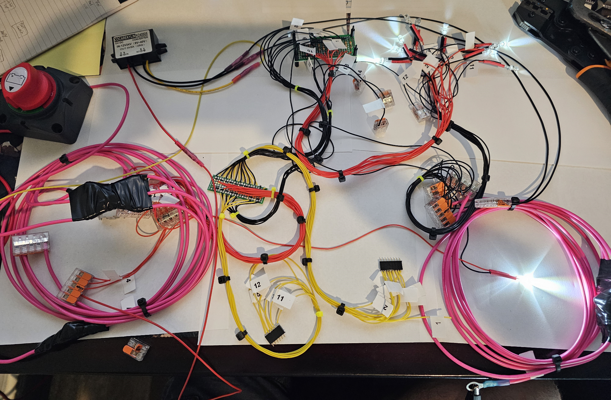
Electrical System: Low Voltage

Slide 10
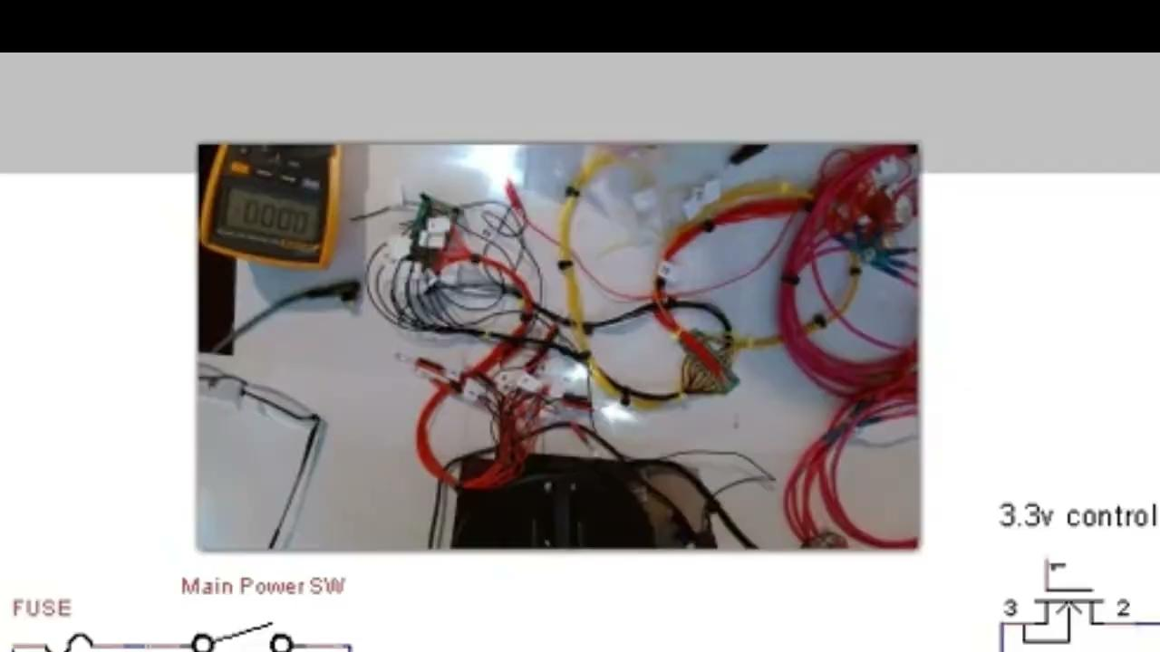
Demo

Slide 11
Electrical System: High Voltage

Slide 12
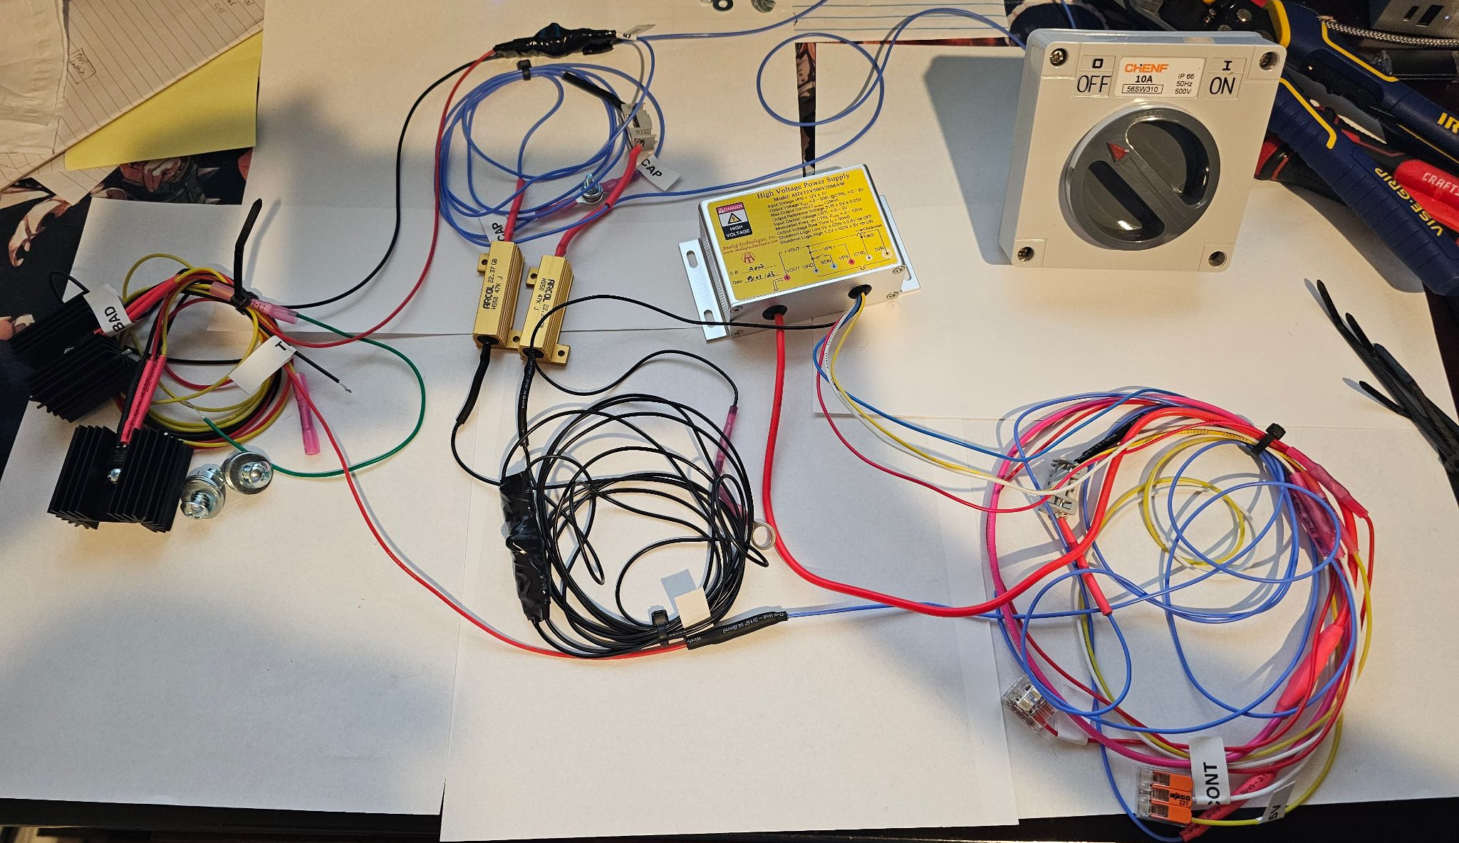
Electrical System: High Voltage

Slide 13
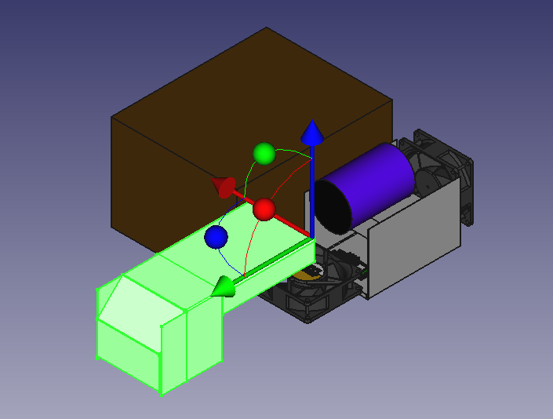
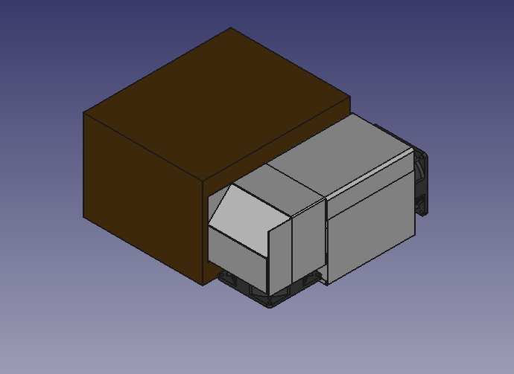
Cooling System: Physical Design
Top Cover Moved to show orientation of components.
Enclosed Airflow Shroud

Slide 14
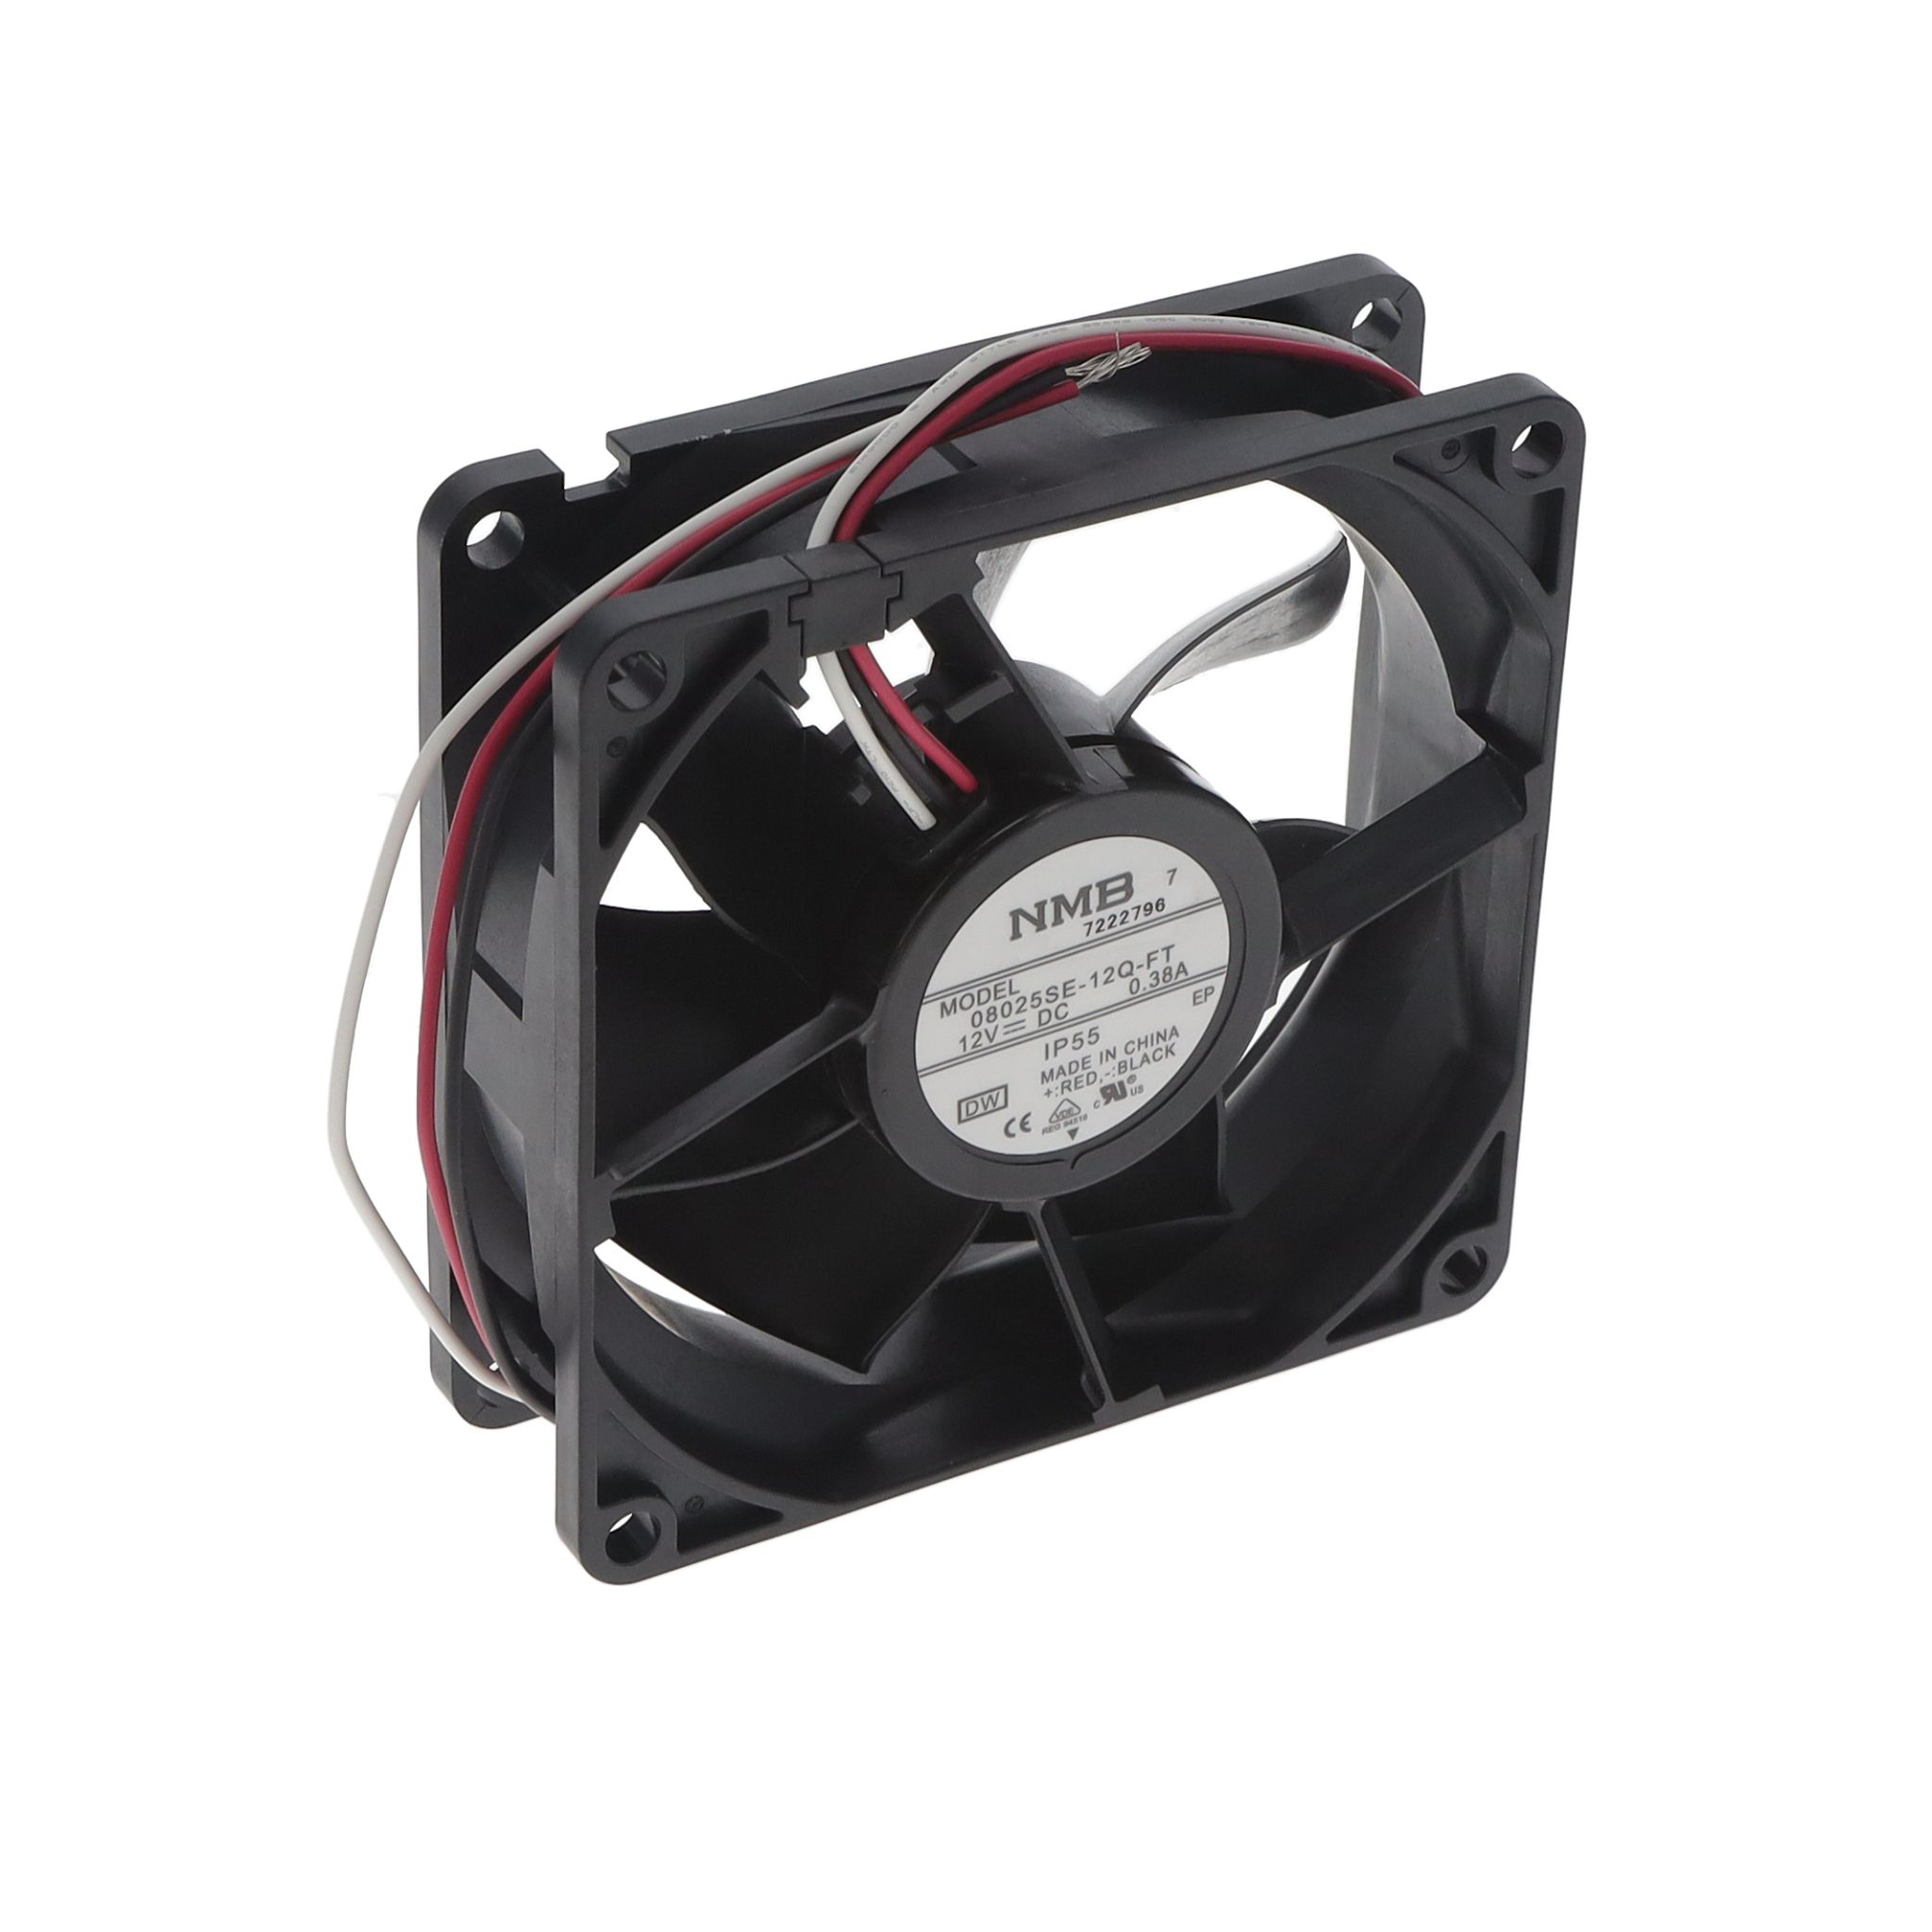
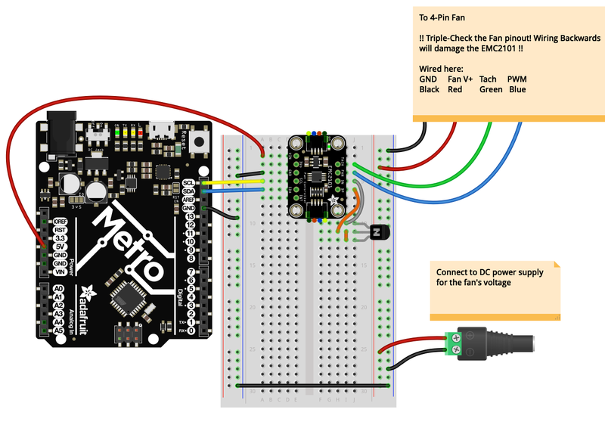
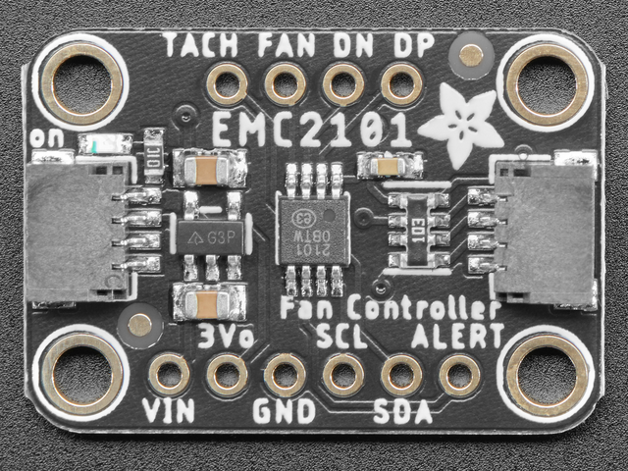
Cooling System: Components
NMB Corp 12VDC, IP55 rated fan
w/EMC2101 Fan Controller
Wiring for programming of EMC2101

Slide 15

Software
The software system includes an autoscript that runs the oscilloscope recording software, a timing system for the RP2040, and user input system to trigger events. In addition, a raspberry pi times the high voltage pulse and sends a 3.3V signal to a mosfet for 500V. Will also send trigger pulse to oscilloscope. Also controls status lights

Slide 16
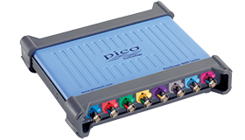
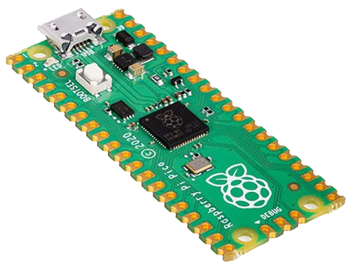
Tx, Rx, And Control System
Current RX/TX System Status:
RX side is assembled with an oscilloscope connected to a minicomputer to record and process data
TX side is a custom electrical circuit that uses a HV capacitor and MOSFET to pulse the transducer
Control System is a RP2040 that starts the system, times pulses, and

Slide 17
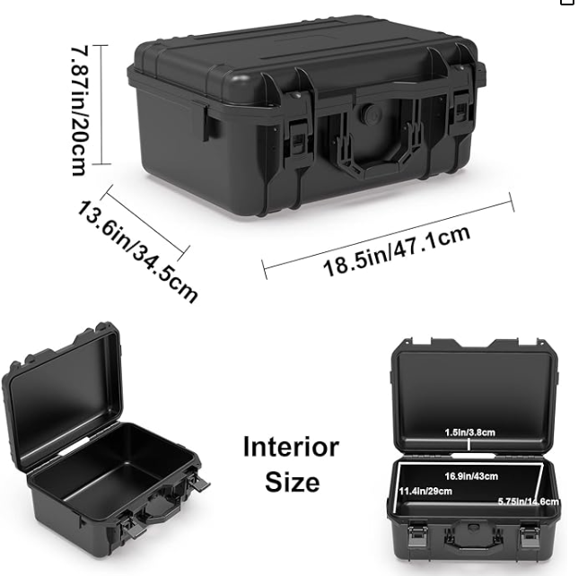
Enclosure And Mounting System
Enclosure
Off the shelf case
Mounting
Determined next semester

Slide 18
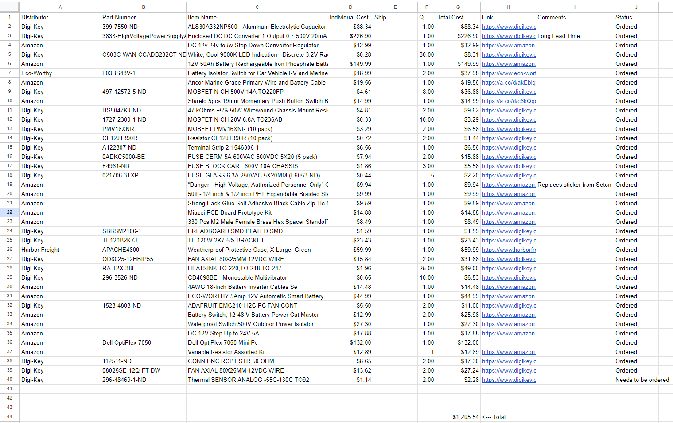
Parts List
Some of our delays came from suppliers taking a while to flag our account as tax exempt, which our funding required

Slide 19
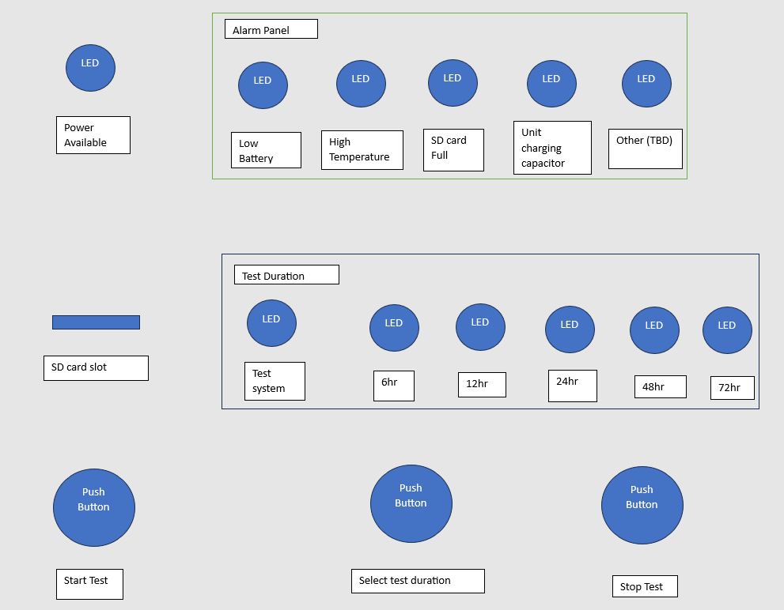
Front Panel Layout

Slide 20
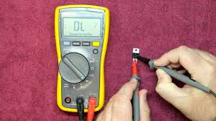
Tests And Validation Of The Design
Test each component individually for correct resistance, voltage, current, .. etc depending upon the part data sheet specifications.
Then connect components and test systems as a whole for proper operation.

Slide 21
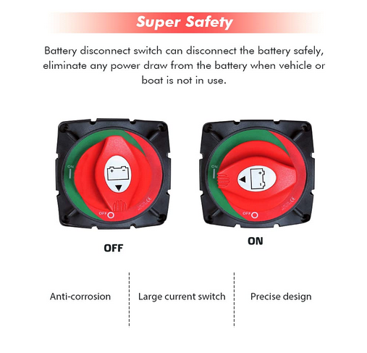
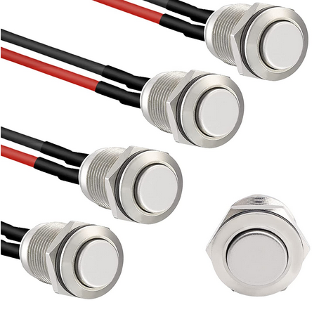
How The Product Meets The Customer Needs/Requirements
The PUD is a portable briefcase sized test unit and is easy to use for a single operator through manipulation of 3 switch and 3 buttons.
The PUD when started by operator initiates testing using a 500v 2μsec pulse test for 50 repetitions then repeating the process over multiple 10-minute intervals for the total test duration. Recording the resulting data on a removable SD card for operator convenience.

Slide 22
How The Product Meets The Customer Needs/Requirements
The PUD is designed to operate for 48 to 72 hours.
The PUD currently costs approximately 1300$ which is less than 2000$ budget.
The PUD has a waterproof case, water resistant operator input buttons, waterproof sealant used for indicating light hole penetrations, and drip resistant fan vents.

Slide 23
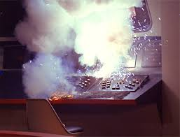

Lessons Learned
Tax free status for ordering parts takes some time and needs to be accounted for in planning.
Components break or are found faulty during testing. Extra components should be ordered if you suspect they are sensitive.

Slide 24

Lessons Learned
Documentation is more resource intensive than originally expected. I would have assigned one team member to only do paperwork and have no other responsibilities.
A systems major would have been useful for better sprint planning. Underutilized the system by having large goals and should have had smaller and shorter term goals.

Slide 25
Current Status
Electrical system - design complete, currently constructing/testing circuit.
Working on high volt section
Cooling system – test, assemble, and mount components
Software – Program Rx/status lights
Tx system – Program pulse
Control system - Program microcontroller
Enclosure system - Currently testing different configurations and layouts

Slide 26
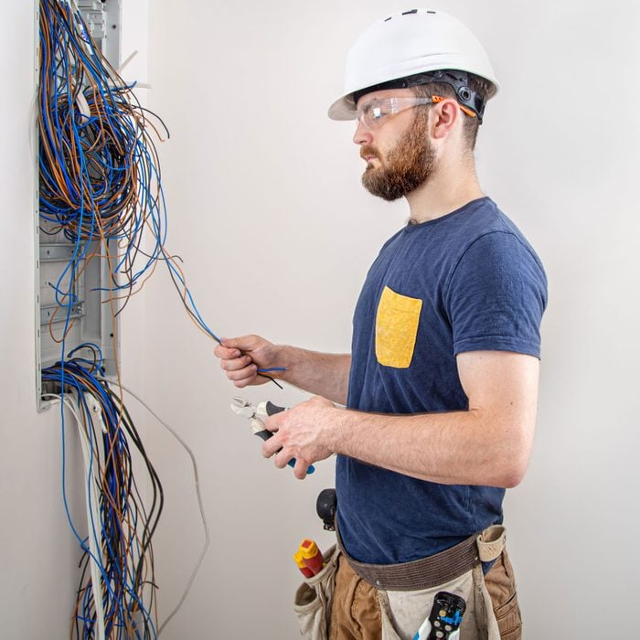
Next Steps (Work Remaining)
Receive parts
Test components individually
Assemble parts into designed system
Mount components systems into casing
Program control systems
Test systems per test plan
Troubleshoot as required

Slide 27

Next Steps
(Future)
Improved software to analyse response data more effectively
Improve software to display data in more easily understood/useful format
Adding more test probes to receive data from more than one test point

Slide 28


Questions?

Slide 29
What is this projects goal?
Produce a handheld ultrasound inspection device for inspecting a bridge/structural component for faults in the field.
This handheld unit gathers and stores test data collected over time 72 hours.
Budget - $2000
Existing commercial solution:
Expensive ($5200)
Is not able to record without an operator present

Slide 30
Background:
Civil engineering lab has a concrete “scanning” process that involves measuring how ultrasonic waves travel through the concrete

Slide 31
Background:
Data analysis (through MATLAB) is able to reveal imperfections in the concrete.
Scan of a proper piece of concrete
Scan of a compromised piece of concrete

Slide 32
Summary of Major requirements
The Portable Ultrasound Device (PUD) shall be portable and usable by a single operator.
The PUD shall initiate testing and record the resulting data.
The PUD shall operate for 48 to 72 hours without exterior inputs.
The PUD shall costs less than 2000$ to construct.
The PUD shall operate in outdoor/ field environment

Slide 33
Roles of the Team Members
Michael Kisellus: Electrical system, SDD,SRS
Christopher Coppedge: Enclosure system, parts and acquisition
Leyton Foxworthy: Software
Matthew Baker: Cooling system
Kyle Fox: Tx and Rx system, Control system

Slide 34
Summary of the final design & product.
Electrical system
Cooling system
Software
Tx and Rx system
Control system
Enclosure system

Slide 35
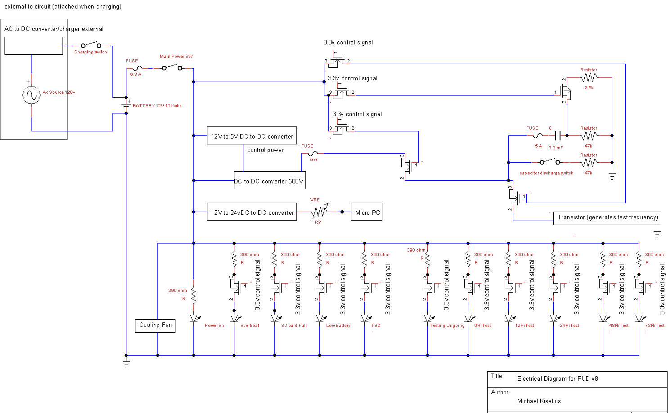

Slide 36
Top Cover Removed to show components
Enclosed Airflow Shroud

Slide 37
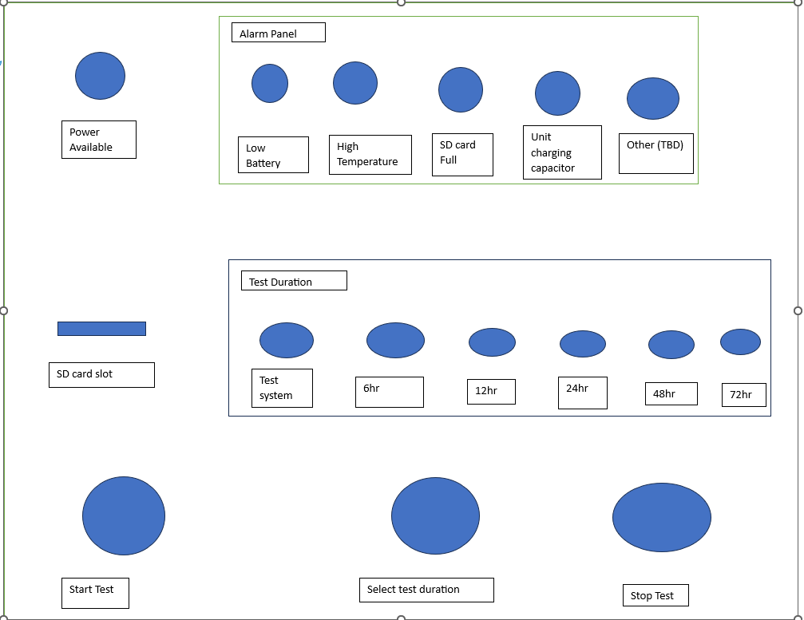
Front panel layout for PUD

Slide 38
Visual Demo (video recording, live demo, etc.)
Remove if no demo available.

Slide 39
Summary of tests and validation of the design
Electrical system
Test each component individually for correct resistance, voltage, current, .. etc depending upon the part data sheet specifications.
Then connect components and test systems as a whole for proper operation.

Slide 40
Discussion for how the product meets the customer needs/requirements.
The PUD is a portable briefcase sized test unit and is easy to use for a single operator through manipulation of 1 switch and 3 buttons.
The PUD when started by operator initiates testing using a 500v 2μsec pulse test for 50 repetitions then repeating the process in 10 minute intervals over the selected test duration. Recording the resulting data on a removable SD card for operator convenience.
The PUD can operate for 48 to 72 hours due to internal power supply and coding.
The PUD costs approximately 1500$ which is less than 2000$ budget.
The PUD has a waterproof case, water resistant operator input buttons, waterproof sealant used for indicating light hole penetrations, and drip resistant fan vents.

Slide 41
Lessons learned and what you could have done differently knowing what you now know.
Tax free status for ordering parts takes some time and needs to be accounted for in planning.
A lot more paperwork than I thought (65 pages of documentation). I would have assigned one team member to only do paperwork and have no other responsibilities.
A systems major would have been useful for better sprint planning. I underutilized the system.
Components break during testing. Extra components should be ordered if you suspect they may break/ sensitive components.

Slide 42
Current Status
Electrical system design complete, currently constructing/testing circuit. Waiting for parts (requires 1 more 500v mosfet).
Cooling system
Software
Tx and Rx system
Control system
Enclosure system

Slide 43
Next steps (Work remaining)
Order/ receive parts
Test components individually
Assemble parts into designed system
Mount components systems into casing
Program control systems
Test systems per test plan
Troubleshoot as required

